Slide 1
EEO COUNSELOR TRAINING – TITLE VII
Jenny K. Chong
Title VII & VI Coordinator
Civil Rights Division
May 2013

Slide 2
CLARIFICATION
Title VI (6) – External Complaints
  Contractors, public members, recipients
  Designees
Title VII (7) – Internal Complaints
  Employees
  EEO Counselors

Slide 3
TITLE VII
CIVIL RIGHTS ACT OF 1964
Title VII of the Civil Rights Act of 1964 prohibits employment discrimination based on race, color, sex, religion, national origin, age, disability or genetic information.
Title VII of the Civil Rights Act of 1964 forbids an employer from retaliating against an employee because of the employee’s opposition to “any practice made an unlawful practice” by Title VII, or the employee’s participation in “an investigation, proceeding, or hearing under [Title VII].” 42 §U.S.C. 2000e-3(a).

Slide 4
BASIS
Race
Color
Sex
Religion
National Origin
Age
Disability
Genetic Information
Retaliation
All phases of employment are covered.

Slide 5
DISCRIMINATION
Basing employment decisions on illegal EEO basis instead of on merit, experience, qualifications
Applies to all aspects of employment:
Hiring
Terms and conditions
Benefits and privileges
Post employment

Slide 6
RACE DISCRIMINATION
Difference in treatment based upon race
Hair texture
Skin color
Facial features
Victim and person can be the same race or color.

Slide 7
COLOR DISCRIMINATION
Difference in treatment based upon color
Pigmentation
Complexion
Skin shade or tone
Notes:
regulations for Title I of GINA, which addresses the use of genetic information in health insurance.

Slide 8
SEX DISCRIMINATION
Glass ceiling issues
Pregnancy
Job segregation
Sexual favoritism
Harassment
Sexual harassment
Notes:
regulations for Title I of GINA, which addresses the use of genetic information in health insurance.

Slide 9
RELIGIOUS DISCRIMINATION
Religious beliefs
Dress codes
Religious expression
Notes:
regulations for Title I of GINA, which addresses the use of genetic information in health insurance.

Slide 10
RELIGIOUS ACCOMMODATION
Belief conflicts with work requirements
Reasonable accommodations
Employee must inform employer of belief/practice in conflict with job duty
Undue hardship

Slide 11
NATIONAL ORIGIN DISCRIMINATION
Physical, linguistic or cultural characteristics
Language and accent
Ethnic slurs and epithets

Slide 12
AGE DISCRIMINATION
Applies to individuals 40 and over
Stereotypes and misconception about abilities
Appearance
  Retirement eligibility
  Years of experience
  Dated education or training

Slide 13
DISABILITY DISCRIMINATION
Assumptions and generalizations
Fear
Lack of awareness
Resistance to individuals deemed “different”

Slide 14
DISABILITY
Physical or mental impairment that substantially limits a major life activity
Record of impairment
Regarded as having impairment

Slide 15
GENETIC INFORMATION
NONDISCRIMINATION ACT of 2008
The law forbids discrimination on the basis of genetic information when it comes to any aspect of employment, including hiring, firing, pay, job assignments, promotions, layoffs, training, fringe benefits, or any other term or condition of employment. An employer may never use genetic information to make an employment decision because genetic information is not relevant to an individual's current ability to work.

Slide 16
GINA EXCEPTIONS
Casual conversation
Voluntary basis – Wellness programs
FMLA leave
Commercially and publicly available documents
Genetic monitoring programs or DNA testing

Slide 17
RETALIATION
All of the laws we enforce make it illegal to fire, demote, harass, or otherwise “retaliate” against people (applicants or employees) because they filed a charge of discrimination, because they complained to their employer or other covered entity about discrimination on the job, or because they participated in an employment discrimination proceeding (such as an investigation or lawsuit).

Slide 18
RETALIATION
Elements of a retaliation claim
Protected activity
Alleged retaliator knew of the protected activity
Adverse action
Causal connection between protected activity and adverse action

Slide 19
SEXUAL HARASSMENT
Unwelcome conduct based on protected basis
Tangible job action
Hostile environment

Slide 20
SEXUAL HARASSMENT
Can involve…
Co-worker
Supervisor
Supervisor in another area
Non-employee (client, contractors, temporary workers, etc.)
Victim and harasser can be any gender
Harasser does not have to be of opposite sex

Slide 21
TITLE VII
WEBSITE INFORMATION

Slide 22
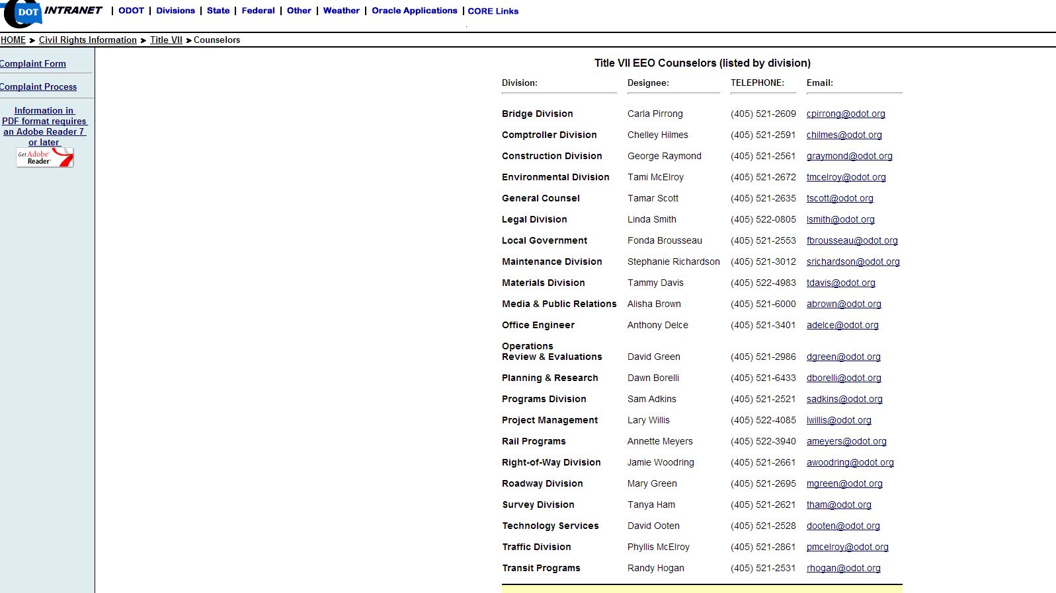
EEO COUNSELORS
INTRANET ONLY

Slide 23
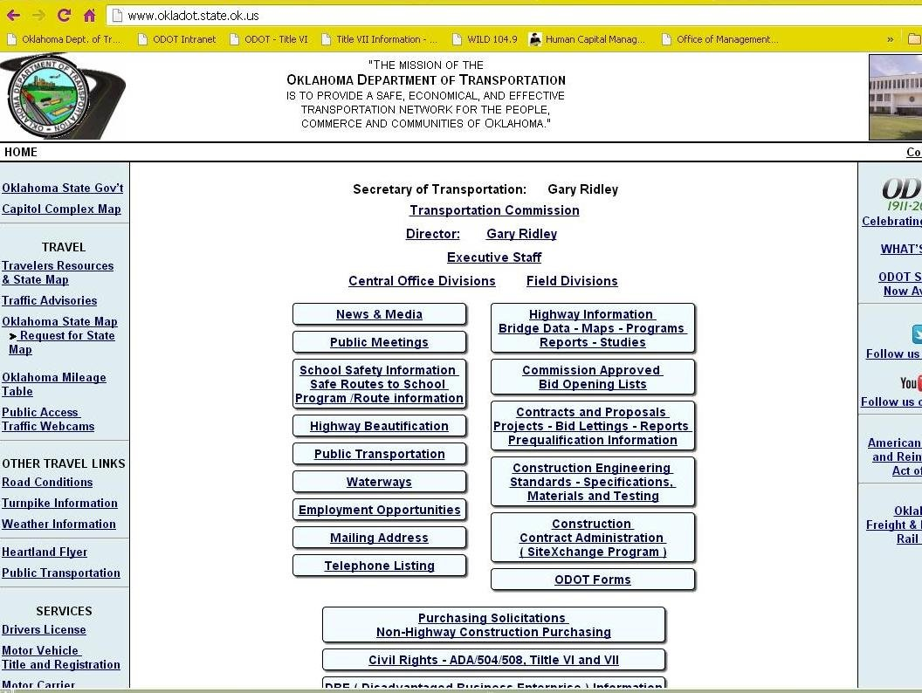
TITLE VII WEBSITE
INTERNET

Slide 24
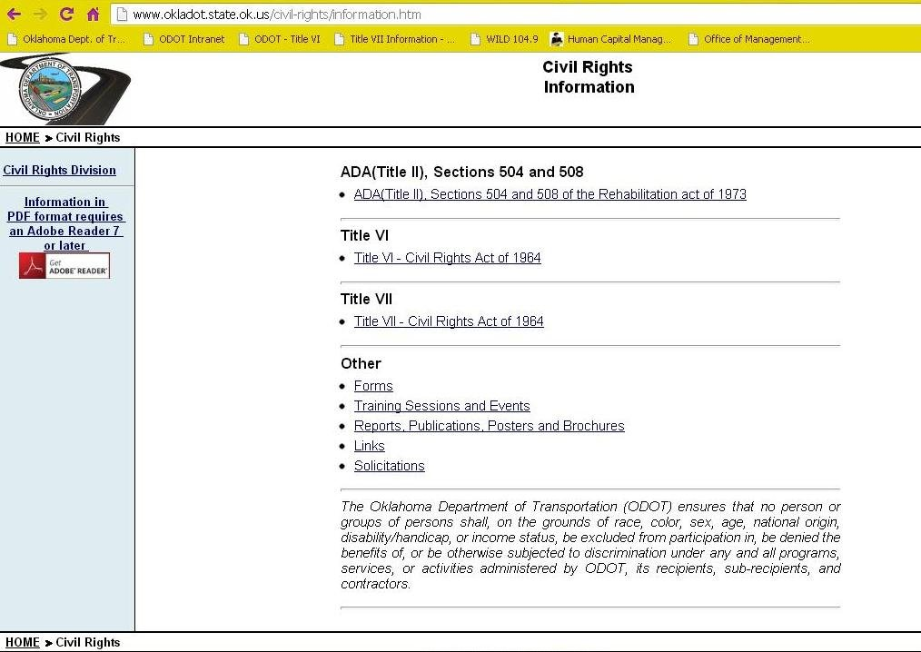
Title VII Website
INTERNET

Slide 25
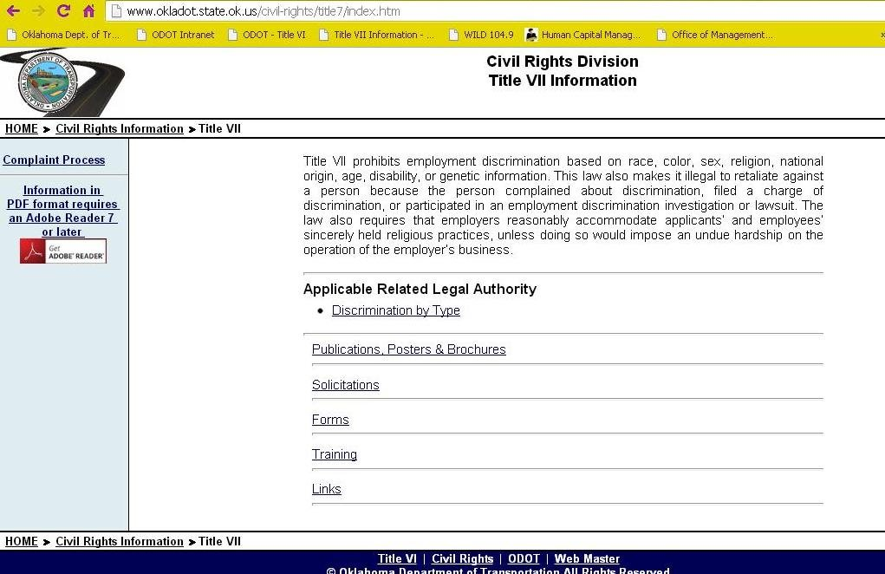
Title VII Website
INTERNET

Slide 26
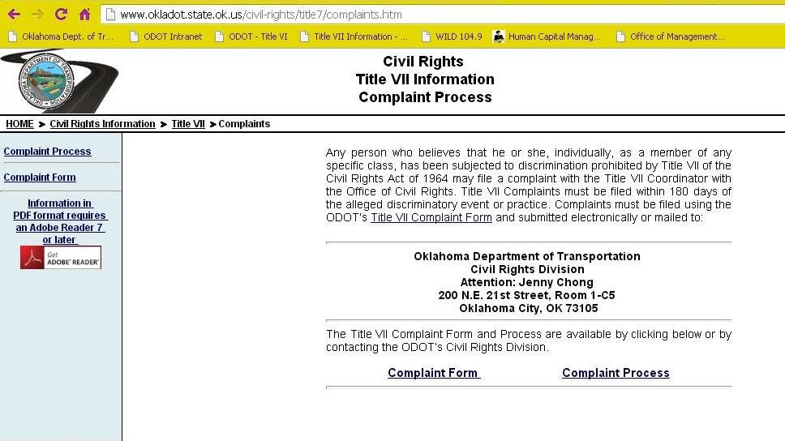
COMPLAINT PROCESS

Slide 27
FORMAL COMPLAINTS – FILING (INTERNALLY)
Individuals can file directly with the:
1. Civil Rights Division
OR
2. Grievance process in Human Resources

Slide 28
MEDIATION
Encouraged to resolve at lowest level
VOLUNTARY
  All individuals must agree in order to take place

Slide 29
BENEFITS OF MEDIATION
Oklahoma Merit Protection Commission’s (MPC) Mediation Program (www.mpc.ok.gov)
Free
Non-bias mediator
Anyone can request
  Venting, personality issues, formal complaints

Slide 30
MEDIATION AGREEMENTS
Signed by MPC Director
Binding by Merit Rules
Grievance can filed if agreement is broken

Slide 31
MEDIATION
Investigation will continue if an agreement is not formed during mediation
Individual does not lose anything by trying mediation first

Slide 32
FILING WITH
CIVIL RIGHTS DIVISION
Form available online or by contacting Civil Rights Division
Filed no later than 180 calendar days following:
    Date of the alleged action of discrimination; or
    Where there has been a continuing course of conduct, the date on which that conduct was discovered

Slide 33
FILING – CIVIL RIGHTS
TIMEFRAMES
Ten (10) business days – Acknowledge receipt
Sixty (60) days – Investigation completed
Ninety (90) calendar days – Final decision by ODOT Director

Slide 34
FILING WITH
HUMAN RESOURCES
Individual uses Grievance Form
Filed no later than 20 calendar days following:
    Date of the alleged action of discrimination; or
    Where there has been a continuing course of conduct, the date on which that conduct was discovered

Slide 35
FILING – HUMAN RESOURCES TIMEFRAMES
* All discrimination grievances will be forwarded to the Civil Rights Division for investigation.
45 calendar days – Resolved
15 days – extend resolution for good cause
30 days – mutually extend resolution
Not to exceed 90 calendar days
ODOT Director makes final decision

Slide 36
FORMAL COMPLAINTS – FILING (EXTERNALLY)
Individual can also file externally with:
Oklahoma Merit Protection Commission
Attorney General’s Office
Equal Employment Opportunity Commission
(EEOC)
Individual can also file in multiple entities (internally & externally)

Slide 37
EEO COUNSELOR’S ROLES & RESPONSIBILITIES

Slide 38
EEO COUNSELOR
Provide information to your division on:
  Title VII website
    Complaint form & complaint process
    Complaint form (let employee fill out the form)
Post notice or inform division you are the EEO counselor
Be alert on any issues can could be discriminatory

Slide 39
EEO COUNSELOR
Be helpful to others in your division
  Remain confidentiality
  Do NOT tell supervisor if employee vents to you (let Civil Rights handle proper procedures)
  Inform Civil Rights Division on formal complaints or potential issues

Slide 40
TITLE VII COORDINATOR CONTACT
Jenny Chong
Title VII & VI Coordinator
Civil Rights Division
(w) 405-521-2072
(c) 405-423-4130
jchong@odot.org

